Slide 1
Telecom Argentina
Sponsored Data
API Proposal
July 2025
Julián Filippini

Slide 2




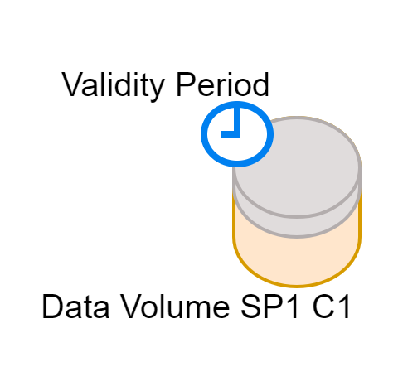
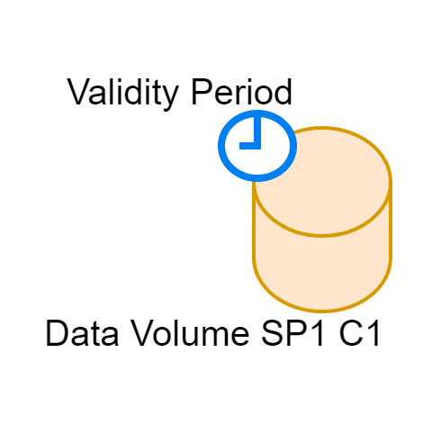
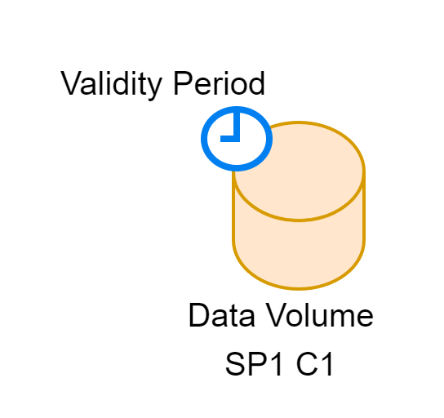

The Proposal
Sponsored Data API
Sponsor
Sponsorship Campaign_ID
Campaigns
Campaigns
Campaigns
Campaigns
UE Session
UE Session
UE Session
2
Notes:
Click each (x) to see the presentation in sync with these points!.
The API:
This API was designed to allow companies from different industries to sponsor mobile data usage for their customers, by covering a specific data volume for a pre-set time period, allowing users to enjoy the service without using their own data quota.
The API is organized in:
(x)Sponsors:
(x)Campaigns: that could be prepaid or post-paid
(x)User Sessions: identified by Session_Ids
The API is structured around (x) Sponsorship Campaigns, where sponsor companies buy (x) a total data volume for a defined period. (x) From this total, individual data quotas are allocated to users participating in the campaign. (x) Each allocation reduces the campaign’s remaining total data volume.
Sponsorship Campaigns can either be prepaid, where companies buy data in advance, or postpaid, where real consumption is billed at the end of the campaign.
Campaigns help companies plan marketing strategies and offer different volumes of sponsored data to different groups of users.
In this initial version of the API, we propose sponsoring general user browsing (x) to any destination (destination server = ANY) without limiting it to a specific destination. The option to sponsor traffic restricted to a particular endpoint is planned for future versions.

Slide 3
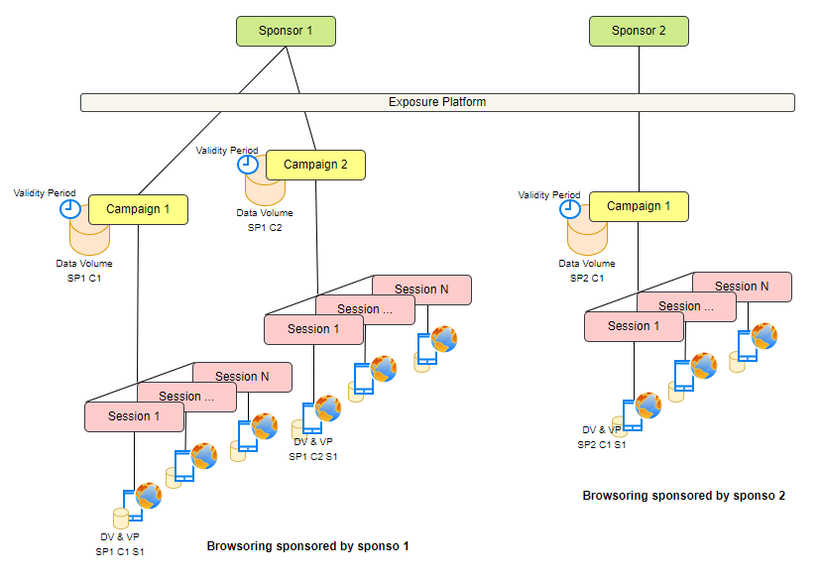
Onboarding Process:
Happens before starting a campaign.
During this process, the following points are defined:
Sponsor_ID
Campaign_ID
Campaign modality
Postpaid
Prepaid -> Campaign Total Data Volume is established
Campaign Duration
Default Sponsorship Profile, consisting of:
Default data volume to be granted per user session (e.g., 100 MB).
Maximum session validity time (e.g., 15 minutes).
These values can later be overridden for each user session through API methods
3
Notes:
Some Api Concepts
Before activating a campaign, there is an important Onboarding Process. In this phase, the sponsor companies, the exposure platform, and the mobile operators agree the campaign’s main parameters.
These include (x) (x) assigning identifiers, deciding if the campaign will be (x) prepaid or postpaid, if the campaign is prepaid, this is when its total data volume is set. (x) setting the campaign validity period, and (x) defining a Default Sponsorship Profile for users.
This Default Sponsorship Profile defines a default data volume and validity period per user for each campaign, but these parameters can be later adjusted through API operations during the campaign lifecycle.
As part of the onboarding process, when the campaign is prepaid, (x) the total data volume to be purchased for the campaign is established.

Slide 4


Service Phases
Phase 1: Onboarding Signatory
Phase 2:
Network Configuration
Phase 3:
API Operation
Onboarding
Doc
Sponsor
Sponsor
Exp Platform
Exp Platform
Operators
Operators
Operators
4
Notes:
We see this service being structured in three main phases:
Phase 1: , (x) Onboarding Signatory
In this phase, the sponsoring company is registered, IDs are assigned, and the default sponsorship profile is agreed.
Phase 2: , (x) Network Configuration
In this phase, the main actor is the Operator, who sets up the network and charging logic.
Phase 3: , (x) API Operation
In this phase, the campaign enters its operational stage through the use of the API. Available operations include starting a session, checking status, revoking a session, checking campaign status, configuring alerts, and more.

Slide 5





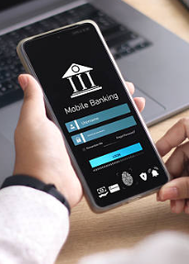
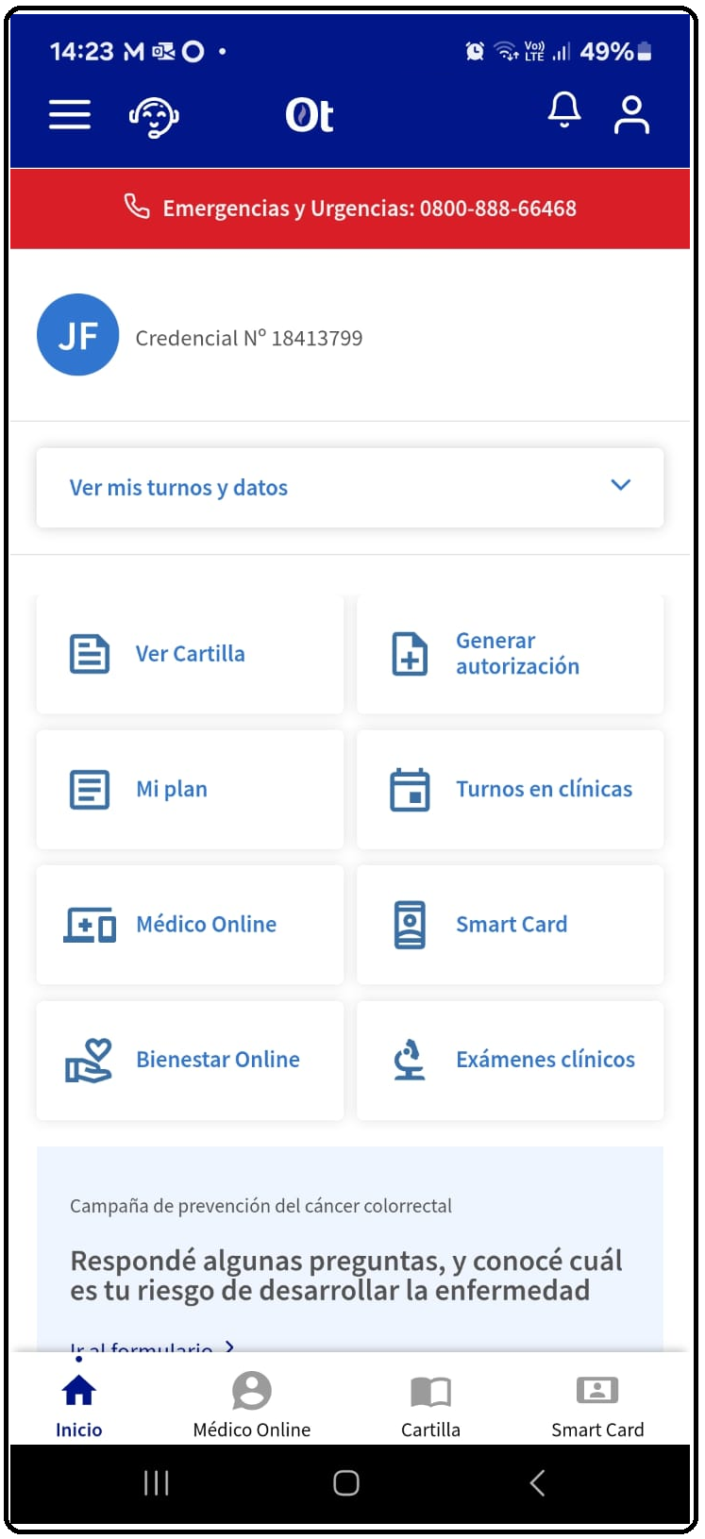

Use Cases
The Sponsored Data API enables businesses to remove the data cost barrier, reinforcing user engagement with
E-commerce Platforms
Educational Platforms
Social Media Campaigns
Entertainment Apps
Government Campaigns.
Healthcare platforms
Banking and Fintech apps
Public service apps
5
Notes:
By removing data costs, this API empowers the following types of services:
(x)E-commerce platforms that want to offer free browsing during special promotions
(x)Educational platforms providing zero-rated access to learning content
(x)Social media campaigns with sponsored interaction time
(x)Entertainment apps offering data-free streaming or previews
(x)Government campaigns ensuring citizens can access key services without data charges
(x)Healthcare platforms – for providing access to medical apps or telehealth services without consuming the user's data
(x)Banking and Fintech apps – zero-rated access to allow users to check balances or make transfers
(x)Public service apps – such as transport updates, emergency alerts, or civic engagement tools

Slide 6
API Operations Related to User Sessions
Operation | HTTP Method | Endpoint | Description
Start Sponsorship | POST | /sponsorship | Initiates a new sponsorship session for a user (Data Volume assigned, Validity Period)
Get Session Status | GET | /sponsorship/{sponsorId}/{campaignId}/{sessionId}/session-status | Retrieves the current status and details of a specific sponsorship session (Data Volume Consumed and Available, end Reason).
Revoke Sponsorship | DELETE | /sponsorship/{sponsorId}/{campaignId}/{sessionId}/session-status | Revokes an active sponsorship session.
6

Slide 7
API Operations Related to Campaign Management
Operation | HTTP Method | Endpoint | Description
Get Campaign Status | GET | /campaign/{sponsorId}/{campaignId}/campaign-status | Returns current campaign status (active, paused, or concluded), and remaining data balance, and validity period.
Retrieve Active Sponsorship List | GET | /campaign/{sponsorId}/{campaignId}/active-sponsorship-list | Lists all users currently under sponsorship in a specific campaign.
Subscribe to Alerts & Notifications | POST | /campaign/{sponsorId}/{campaignId}/alert-subscription | Subscribes the sponsor to notifications about campaign event. (DATA_VOLUME_THRESHOLD_EXCEEDE_ (80%), DATA_VOLUME_EXHASTED, CAMPAIGN_EXPIRED)
Campaign Management | POST | /campaign/management | Allows campaign-level action settings (PAUSE, RESUME)
7
Notes:
Let’s see the API in action through a few slides.

Slide 8
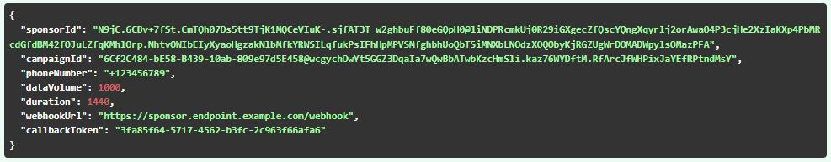
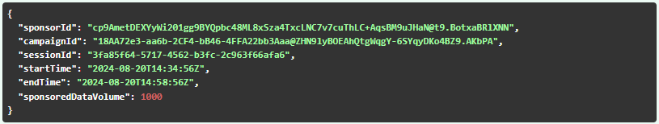
API Operations
/sponsorship Start Sponsorship Session Request
POST /sponsorship
Successful operation. New sponsorship session created.
8
Notes:
Let’s see the API in action through a few slides.

Slide 9
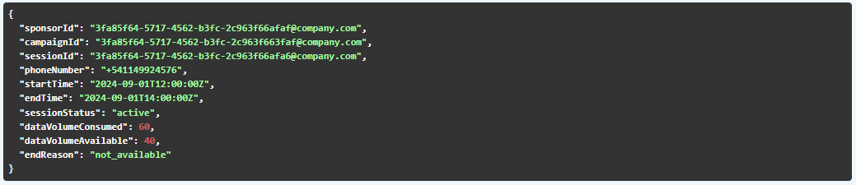
API Operations
/session-status Sponsorship Session Status Inquiry
GET /sponsorship/{sponsorId}/{campaignId}/{sessionId}/session-status
Successful operation. Contains information about the sponsorship session
9
Notes:
Let’s see the API in action through a few slides.

Slide 10
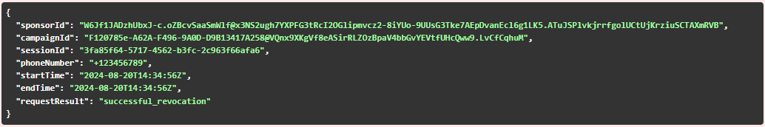
API Operations
/session-revoke Revocation of Sponsorship
DELETE /sponsorship/{sponsorId}/{campaignId}/{sessionId}/revoke
Successful operation. Session revoked successfully
10
Notes:
Let’s see the API in action through a few slides.

Slide 11
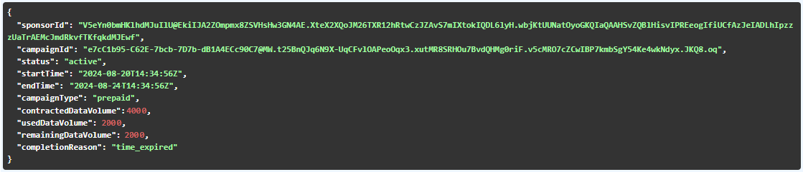
API Operations
/campaign-status Campaign Status Inquiry
GET /campaign/{sponsorId}/{campaignId}/campaign-status
Successful operation. Returns the status of the campaign
11
Notes:
Let’s see the API in action through a few slides.

Slide 12
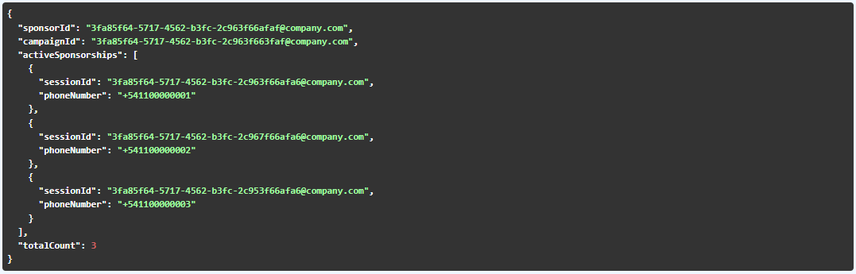
API Operations
/active-sponsorship-list Query of Active Sponsorships
GET /campaign/{sponsorId}/{campaignId}/active-sponsorship-list
Successful operation. List of users currently sponsored by the campaign.
12
Notes:
Let’s see the API in action through a few slides.

Slide 13
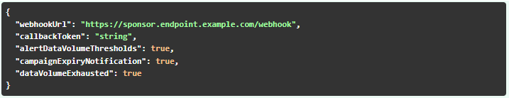
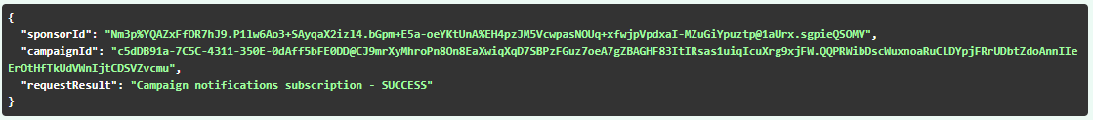
API Operations
/alert-subscription Campaigns - Subscription to Alert y Notifications
POST /campaign/{sponsorId}/{campaignId}/alert-subscription
Successful operation. Campaign notifications subscription - SUCCESS
13
Notes:
Let’s see the API in action through a few slides.

Slide 14
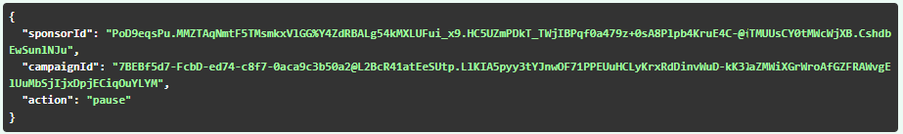
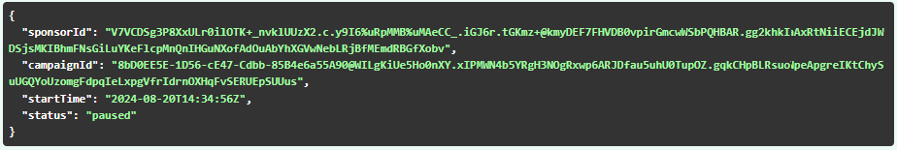
API Operations
/management Campaign Management
POST /campaign/management
Successful operation.
14
Notes:
Let’s see the API in action through a few slides.

Slide 15
For more information about this API, visit:
GitHub → CAMARA PROJECT → APIBacklog → Issue #223
15

Slide 16
¡Thanks!
Notes:
Thank!

